Slide 1
CS-Studio: Logging

Slide 2
Olog

Slide 3
Requirements
Basic functionality
Web service
Authentication
Multiple logbooks, tags
Create log entry
Edit log entry
Attach files
Search
Simple Web client

Slide 4
Requirements
Integration
IRMIS
Component/Inventory
Physics data
Save/restore
CSS plug-in
Operations
Beam statistics
Down time/tuning time/beam on target
Bypass records
On shift records
Trouble Reports
Experiment records

Slide 5
Log Entry
Time
Owner
Text
Attachments
Logbooks
Tags
Properties
Notes:
It might be useful to start with describing what a log entry contains
Each log Entry has a create time, an owner, some text and may also contains some attachments – attachments can be any files
Additionally
Log entries have one or more logbooks and may have one of more tags – both logbook and tags provide a useful way of categorizing and grouping log entries into different logical groups.
Finally we have properties which can be seen as a set of key values pairs

Slide 6
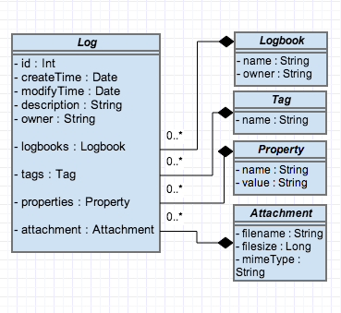
Log Entry

Slide 7
Publish/subscribe
Command/response
v3
v4
IOC
IOC
…
IOC
IOC
…
v4
CA client (JCA/CAJ)
pvA client
Masar
…
Core Client Technologies
Data Sources
CA
Sim
Test
pvA
Aggregation
pvManager
AccelUtils
Java/Python
Web based REST services
Data Definition
vTypes
API
ChannelFinder
Visualization
Graphene
API
Olog
CSS Core
ChannelFinder Integration
Olog Integration
…
...
Log Viewer
BEAST
BOY
Web UI and other clients
Scripts and utilities
DataBrowser
Logbook
pyOlog
…
CS-Studio
…
…
Notes:
To begin with this slides gives an overview of the various pieces that represent the architecture of our controls and high level physics applications, tools and services along and their relation ship with each other.
// maybe
Epics (both v3 and v4) is the control system we use
The core technologies provide the means to efficiently communicate with the Control system
CS-Studio is our primary user interface tool

Slide 8
Olog Web service
Create and modify log entries
Search
Organize entries using multiple logbooks, tags and properties.
Integration with other tools/service
Control System (epics v3, v4)
CS-Studio
Physics Data
Save Restore
…..
Notes:
Functions of the olog service
The ability to create and modify log entries
Functionality to search
The ability to organize log entries in multiple groups using logbooks, tags and properties
Integrations with other tools and services like the controls system, applications in cs-studio and physics applications and services like save restore

Slide 9
Olog Client Libraries
Currently there is support for 2 languagues
Python
Java
Manage network communication
Creating HTTP request
Setting up connection and Authorization
Parsing json/XML into java or python objects
Provide Utility Methods
Notes:
To handle n/w connection like setting up the connections, managing the authentication, creating the HTTP requests
It also does the parsing of the XML or json data coming from the server to language specific objects
Provides common utility methods to manipulate the data returned by the service

Slide 10
CS-Studio & Olog

Slide 11
Publish/subscribe
Command/response
v3
v4
IOC
IOC
…
IOC
IOC
…
v4
CA client (JCA/CAJ)
pvA client
Masar
…
Core Client Technologies
Data Sources
CA
Sim
Test
pvA
Aggregation
pvManager
AccelUtils
Java/Python
Web based REST services
Data Definition
vTypes
API
ChannelFinder
Visualization
Graphene
API
Olog
CSS Core
ChannelFinder Integration
Olog Integration
…
...
Log Viewer
BEAST
BOY
Web UI and other clients
Scripts and utilities
DataBrowser
Logbook
pyOlog
…
CS-Studio
…
…
Notes:
To begin with this slides gives an overview of the various pieces that represent the architecture of our controls and high level physics applications, tools and services along and their relation ship with each other.
// maybe
Epics (both v3 and v4) is the control system we use
The core technologies provide the means to efficiently communicate with the Control system
CS-Studio is our primary user interface tool

Slide 12

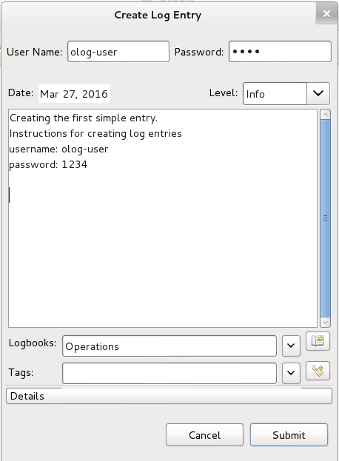
Creating simple log entries
Create log entry
Toolbar
Context Menu
Create log entry dialog
Required
Authentication/Authorization info
Log description
Logbook
Level
Optional
Tags
Attachments
Properties

Slide 13
Olog Clients – CS-Studio
CS-Studio is an eclipse based framework for developing controls and physics applications
Seamless integration with applications
Log Entries initialized with application specific information
Notes:
Cs-studio is a eclipse RCP for controls and physics tools
The integrated environment provides a
A use case
An alarm occurs, right click create log entry
The log entry dialog is initialized with the alarm pv, status etc.
Additionally you may also attach some time information so that when other people are reviewing the log entry they can easily bring up the other applications

Slide 14
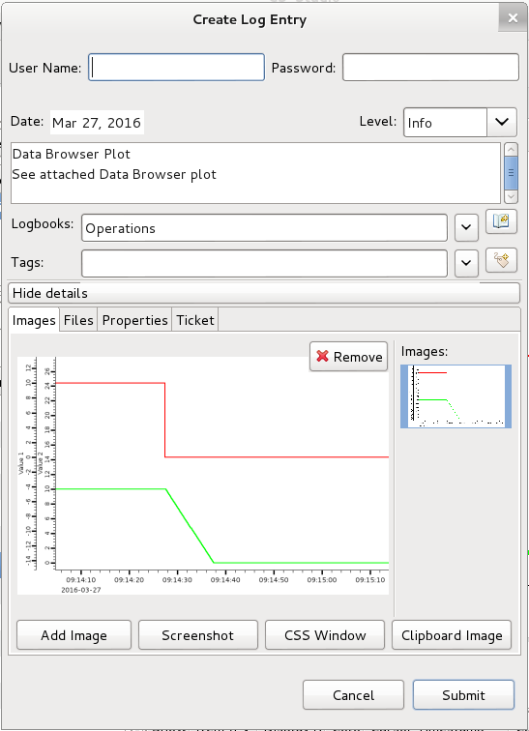
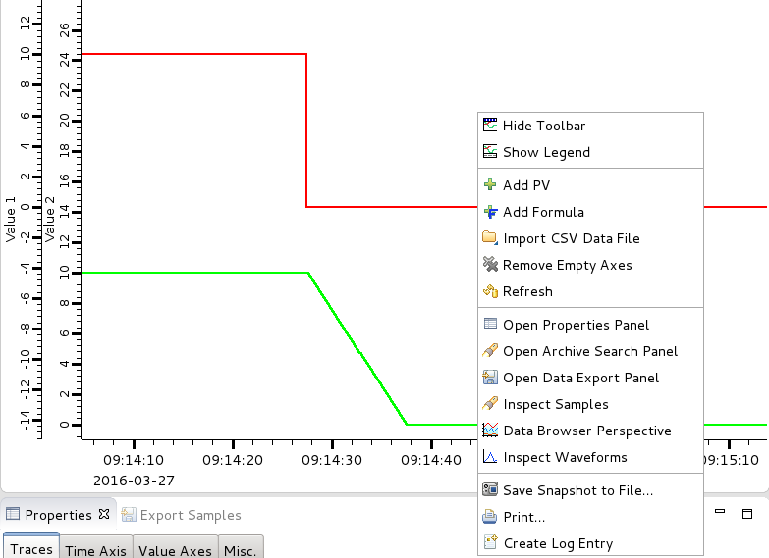
Creating log entries from applications (Databrowser)

Slide 15
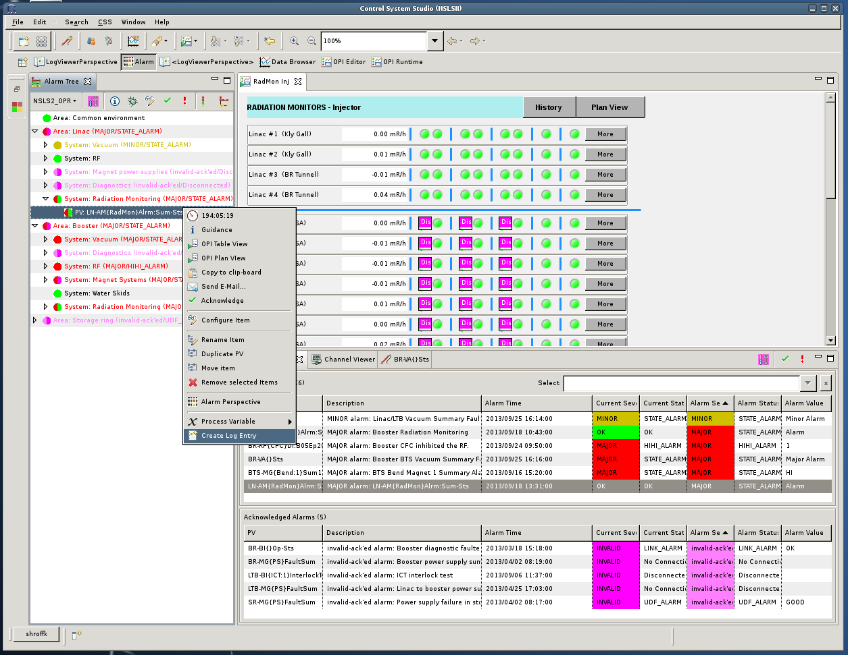
Creating log entries from applications (Alarm)

Slide 16
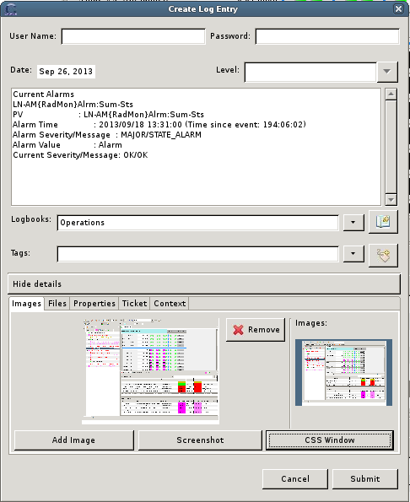
Creating log entries from applications (Alarm)
Alarm server
PV name
Alarm status
Alarm time
Notes:
Cs-studio is a eclipse RCP for controls and physics tools
The integrated environment provides a
A use case
An alarm occurs, right click create log entry
The log entry dialog is initialized with the alarm pv, status etc.
Additionally you may also attach some time information so that when other people are reviewing the log entry they can easily bring up the other applications

Slide 17
Logviewer
Search and view log entries from the Olog server

Slide 18
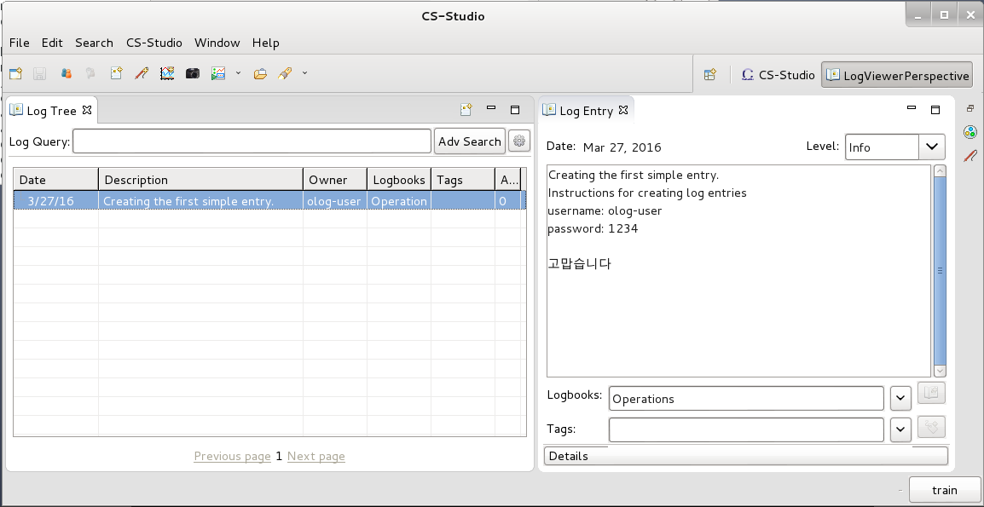
LogViewer
Menu: Window → New Perspective → LogViewer Perspective

Slide 19
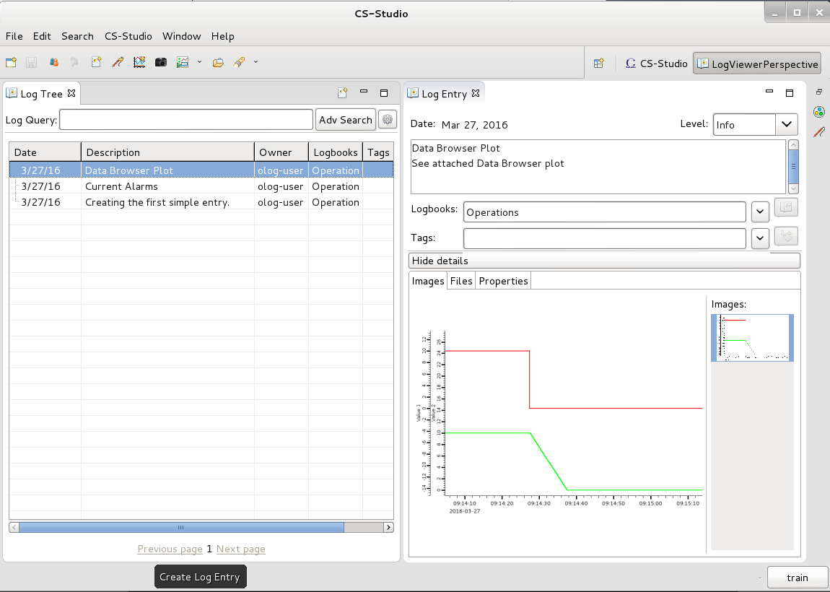
LogViewer

Slide 20
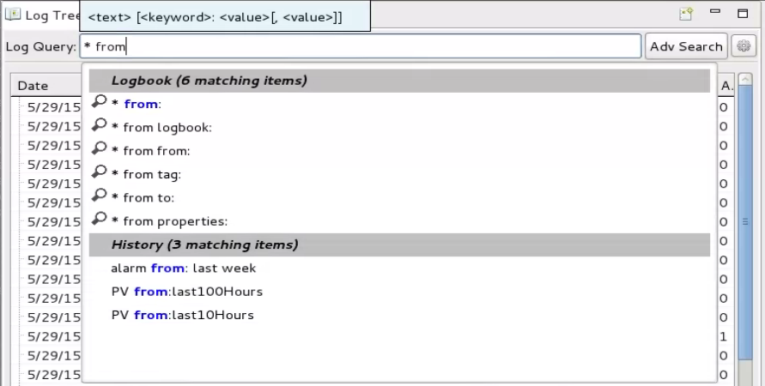
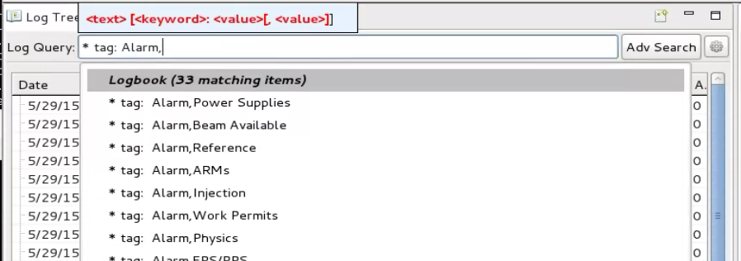
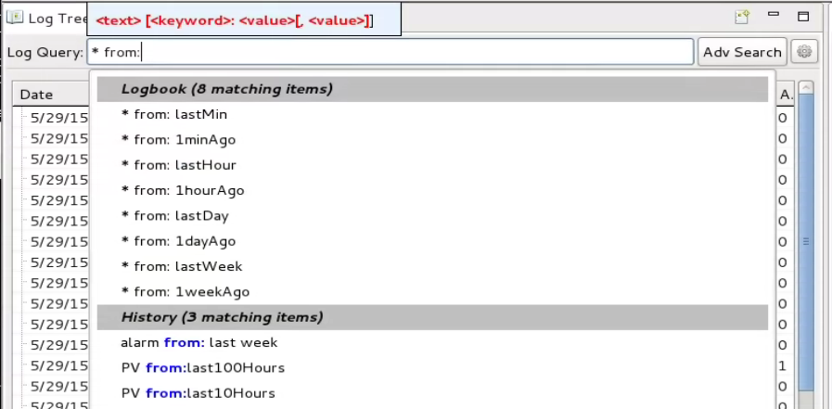
LogViewer: Search
Text search from the description or any text file attachments by simply typing the words
Keywords
logbook, tag, to and from
History
Wildcards
* and ?
e.g.
“Alarm from:last8Hours”
Adv Search dialog

Slide 21
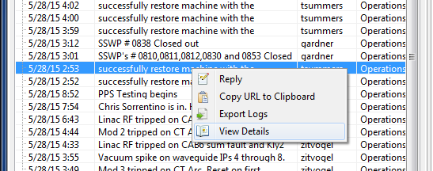
Log Entry context menu
Reply:
Open a dialog allowing you to edit a log entry
Copy URL to clipboard:
Provides the externally visible URL to access this specific log entry
Export Logs:
Export parts of the log entry to a .csv file
View Details:
Opens the log entry in the log entry details view (same as double click)

Slide 22
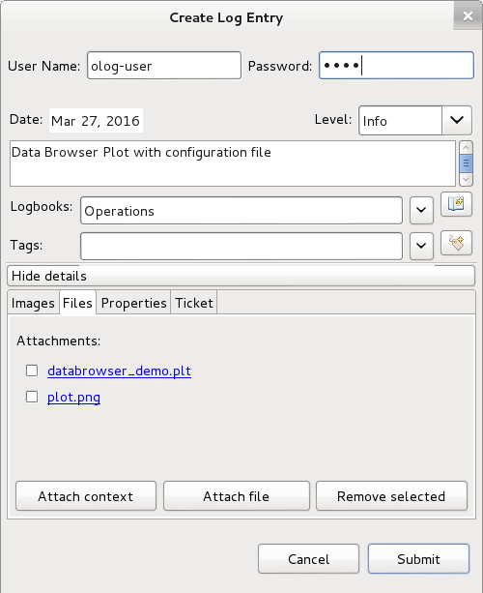
Rich Log Entries
Save Context
Configuration files for cs-studio applications (.plt)
Controls system data (List of process variables)
Information related to other services (Trac tickets , ChannelFinder queries)

Slide 23
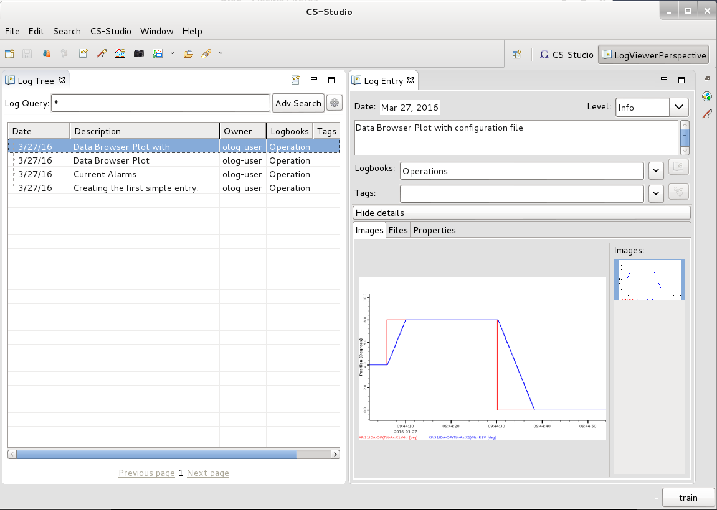
Olog Clients – CS-Studio

Slide 24
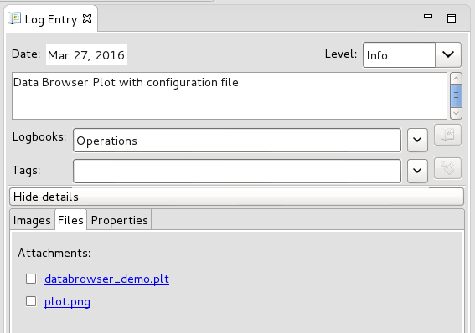
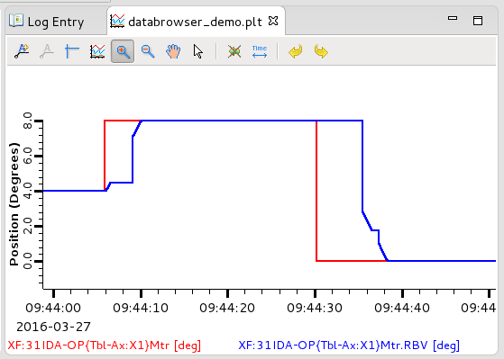
Olog Clients – CS-Studio
Restore Context
Launch applications initialized to the state as described while making the log entry
Open archived data for associated pv’s
Run OPI screens
Query other services

Slide 25
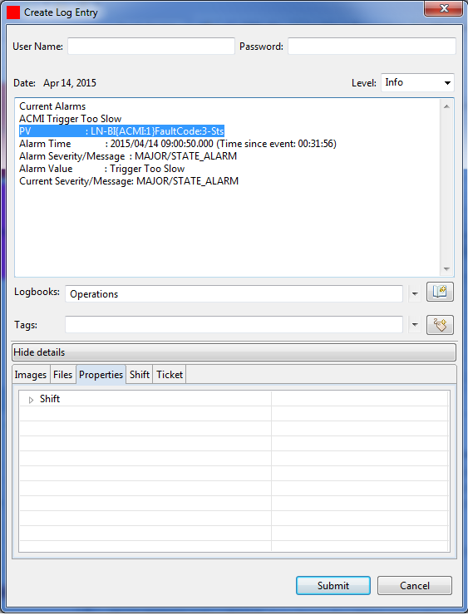
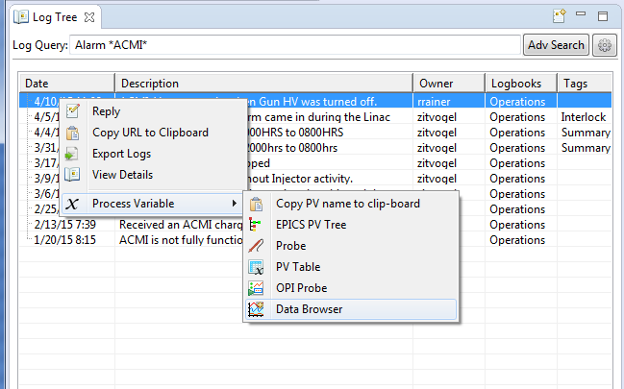
Log Entries with PVs
If log entries contain pv names defined with a specified format, cs-studio is able to extract that pv information from the log entry.
CS-Studio will add the “Process Variable” sub menu to the context menu when it can extract a PV.
The default syntax is PV:<PVName >/n, however we can define any regular expression for recognizing pv names.
e.g.
PV: XF:31IDA-OP{Tbl-Ax:X1}Mtr

Slide 26
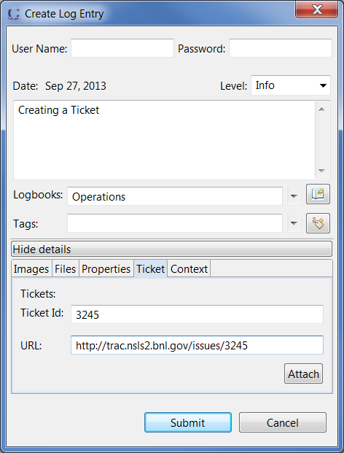
Olog Clients – CS-Studio
Adapters
Provide dynamic runtime integration with cs-studio applications
Maintain loose coupling
Extensions
Pluggable UI
Notes:
Using the eclipse RCP technology
The adapter framework
The adapter pattern is used extensively in Eclipse. The use of this pattern allows plug-ins to be loosely coupled, yet still be tightly integrated in the extremely dynamic Eclipse runtime environment.
Each application simply defines how to its model or context maps to a logEntry…eg, that is it. The application does not need to worry about creating/initializing/managing a log client, providing the UI pieces, etc…

Slide 27
Web client

Slide 28
Publish/subscribe
Command/response
v3
v4
IOC
IOC
…
IOC
IOC
…
v4
CA client (JCA/CAJ)
pvA client
Masar
…
Core Client Technologies
Data Sources
CA
Sim
Test
pvA
Aggregation
pvManager
AccelUtils
Java/Python
Web based REST services
Data Definition
vTypes
API
ChannelFinder
Visualization
Graphene
API
Olog
CSS Core
ChannelFinder Integration
Olog Integration
…
...
Log Viewer
BEAST
BOY
Web UI and other clients
Scripts and utilities
DataBrowser
Logbook
pyOlog
…
CS-Studio
…
…
Notes:
To begin with this slides gives an overview of the various pieces that represent the architecture of our controls and high level physics applications, tools and services along and their relation ship with each other.
// maybe
Epics (both v3 and v4) is the control system we use
The core technologies provide the means to efficiently communicate with the Control system
CS-Studio is our primary user interface tool

Slide 29
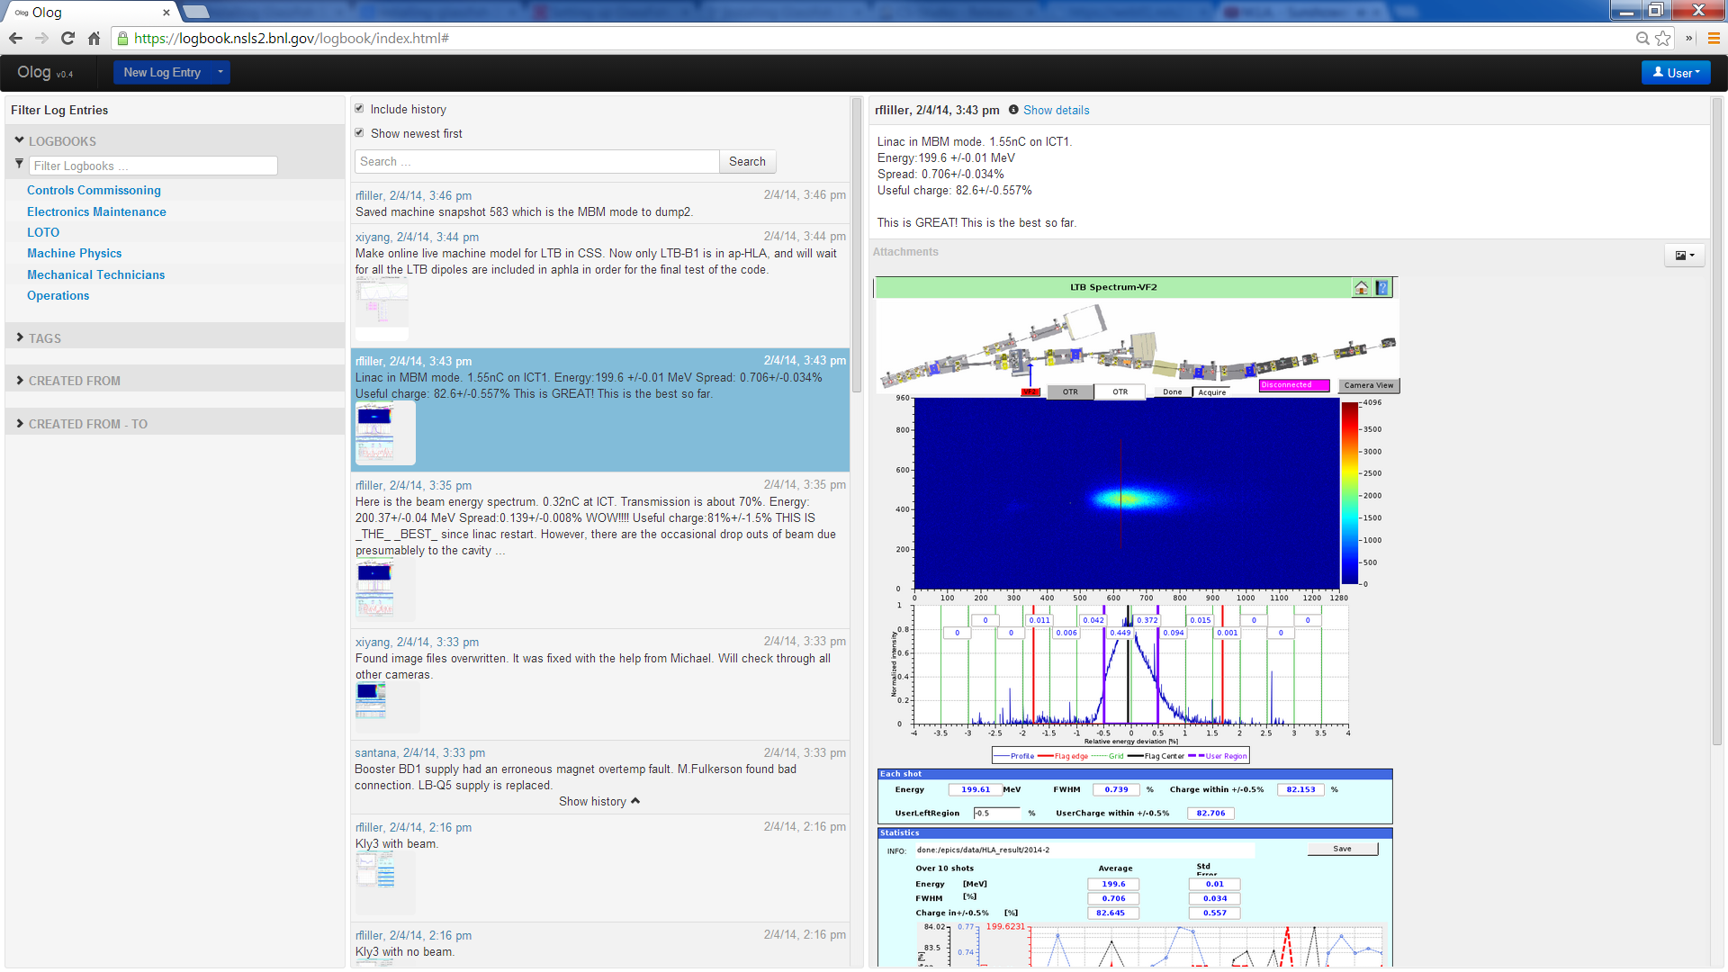
Olog Clients – Webclient
Notes:
A simple, portable webclient which provides the basic functionalities of being able to create, modify and search for log entries

Slide 30
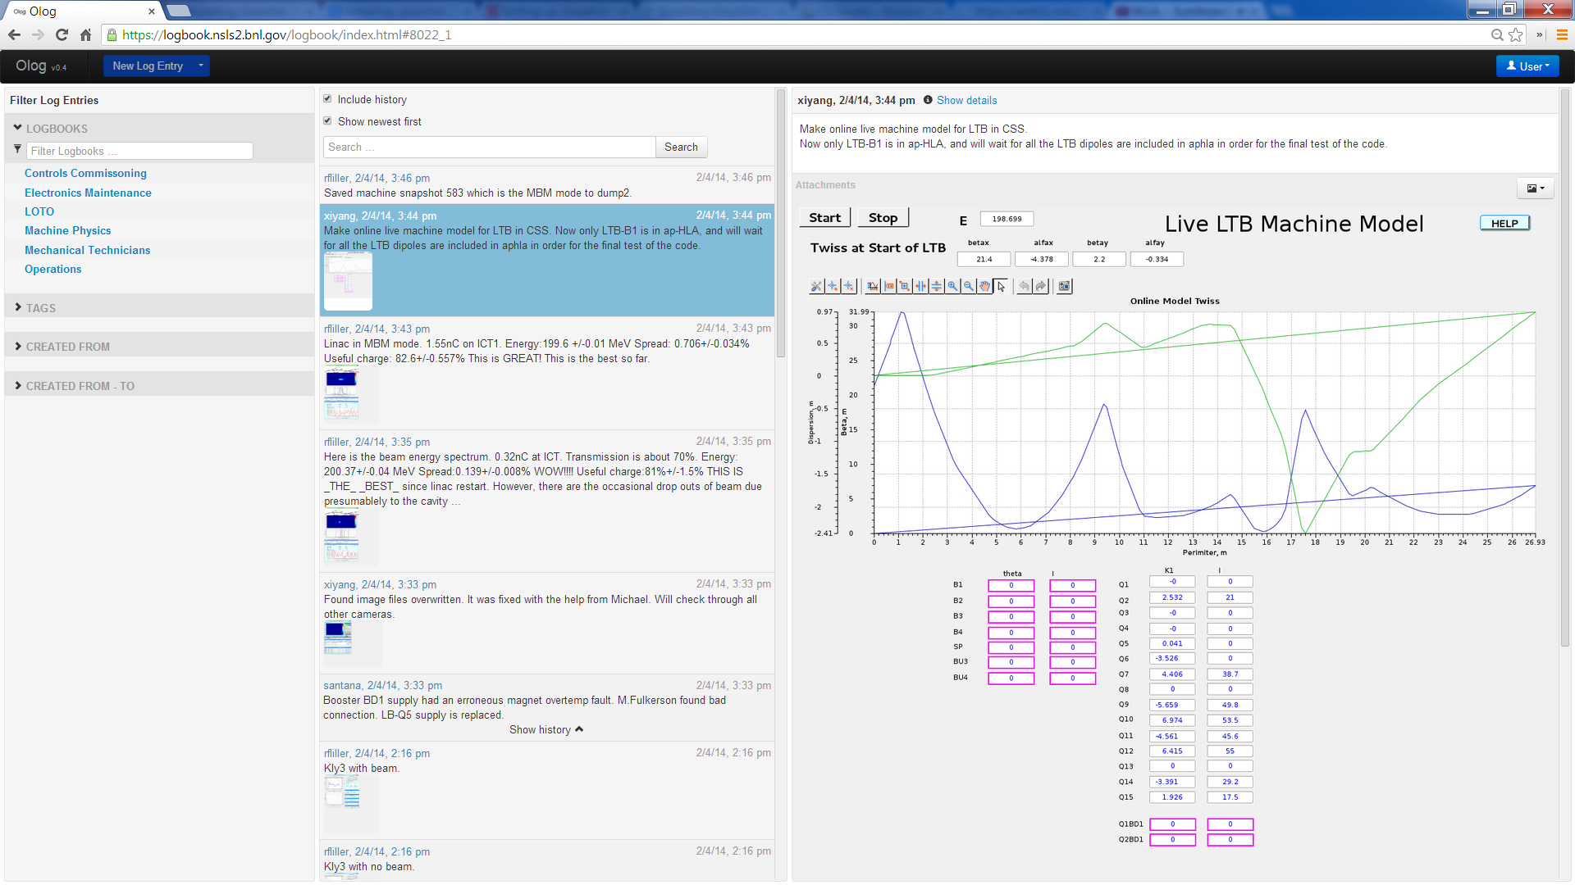
Olog Clients – Webclient
Notes:
A simple, portable webclient which provides the basic functionalities of being able to create, modify and search for log entries

Slide 31
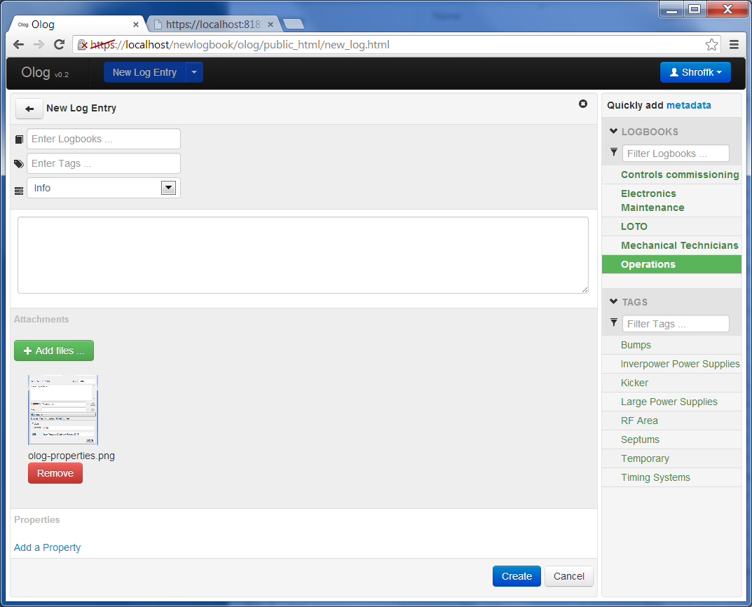
Olog Clients – Webclient
Notes:
Screen shots

Slide 32
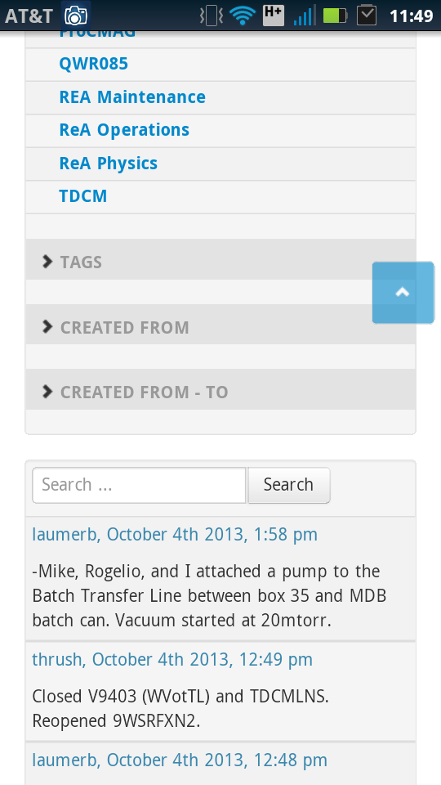
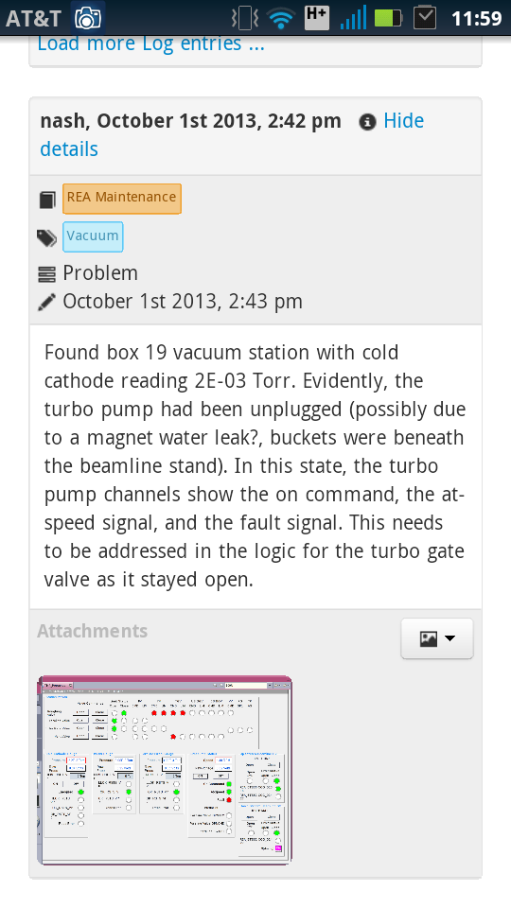
Olog Clients – Webclient
Notes:
Bootstrap – responsive feature

